Slide 1
CS461 Proposal
Remote Unlocking System for Older Vehicles

Slide 2
Introduction

Slide 3
features at a high level
This project is designed to add remote unlocking, locking and keyless entry to older vehicles that do not have these features.
The key fob functions as a normal key fob.
The receiver unit detects your presence
Automatically unlocks the car
The receiver unit automatically locks vehicle when key is no longer detected
Notes:
As an introduction, this project is designed to add unlock and locking via a remote key and also provide some keyless features to older vehicles (my own).
The key itself should be able to function as a normal key fob.
The receiver unit in the car will detect your presence and automatically unlock the car when you are close
The receiver unit should be able to automatically lock the vehicle when the key is no longer detected

Slide 4
Components at a high level
Hardware (Microcontrollers)
Languages (C++ and MicroPython)
Security
Communication
Range finding
Notes:
For the components of this project, I will be looking at these 4 things:
Hardware, for this I will only talk about microcontrollers, because the hardware that would physically unlock the car door is out of the scope of this project
Languages, the languages that I have a choice of are C++ and MicroPython
Security, how can I only allow my device to unlock the door?
Communication, how will the keyfob talk to the car?
Then lastly, I have range finding (such as how far away the keyfob is from the car)

Slide 5
Competing projects
Notes:
Before diving into the components of this project, I would like to mention the only similar project I could find.

Slide 6
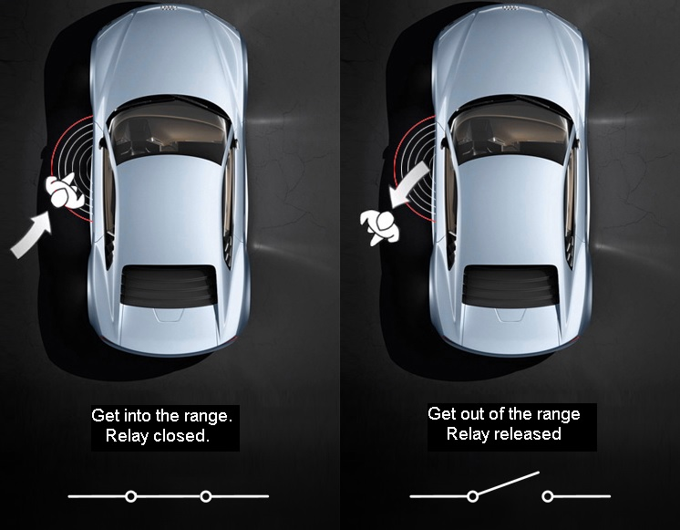
Open remote-keyless-system
Proximity remote entry system available on GitHub
Uses Bluetooth signal
Made for cars that already have keyfob
Connects to phone
Does not include buttons
Notes:
Open Remote-Keyless-System (RKS for short) is a proximity remote entry system designed for vehicles available on GitHub.
Open RKS uses a Bluetooth signal to determine the range of the user (either through a paired phone or dedicated key)
Originally developed to use an Arduino Microcontroller with external Bluetooth chip, has since been modified to work with a more modern
Arduino with built in Bluetooth.
Built for cars that already have electronic remote unlocking built in but just don’t have the keyless entry part.
Connects to a user’s phone and does not provide the functionality of a normal keyfob

Slide 7
Hardware
Notes:
Now for the first component of my project, Hardware.

Slide 8
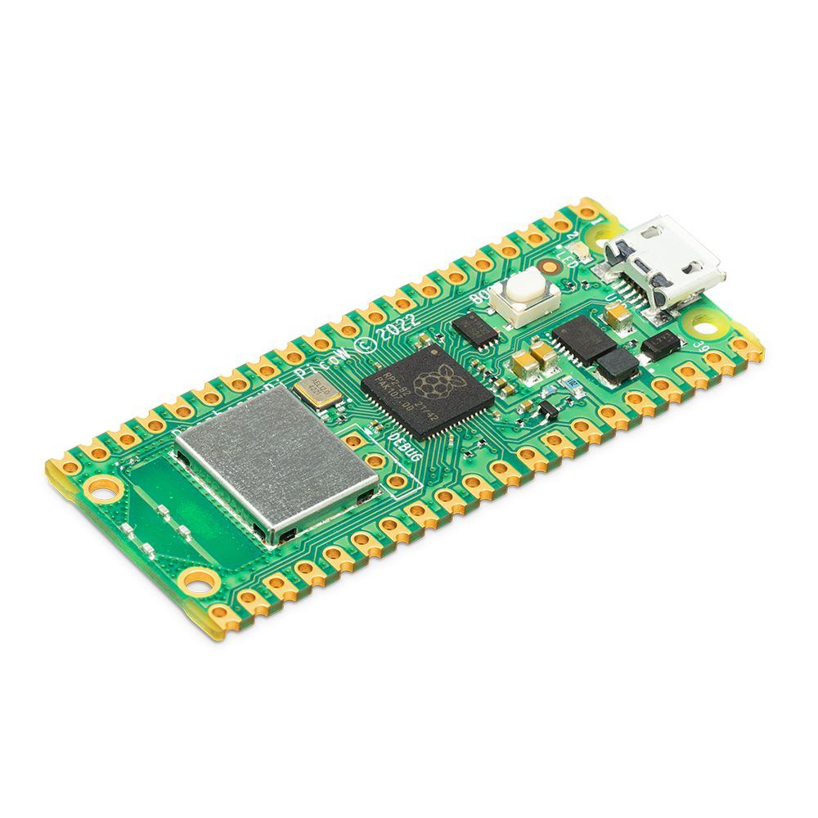
Raspberry Pi pico w
0.69 Watts Max Power Draw
32bit Dual core @ 133 MHz
264 KiB RAM / 2 MB ROM
WiFi Only
Notes:
My first option is the raspberry pi pico w, this little board is very power efficient, only a maximum of 0.69 Watts of power at the maximum.
It’s powered by what the raspberry pi organization calls a M0 class arm chip, this chip is a 32bit dual core running at 133 MHz.
It has 264 KiB of RAM and 2 MB of program storage.
And currently it only supports wifi but hopefully Bluetooth will be added in the firmware sometime in the future.

Slide 9
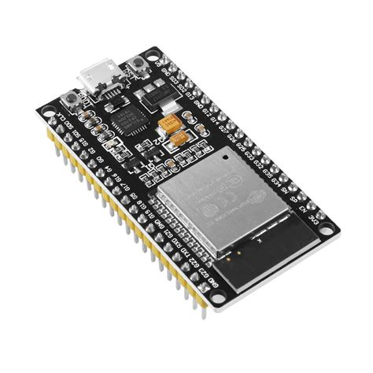
ESP32
0.83 Watts Max Power Draw
32bit Dual core @ 240 MHz
520KiB RAM / 488 KiB ROM
WiFi, BLE, ESP-NOW
Better for my project
Notes:
My second option is the ESP32, this board is slightly less power efficient than the pico but that is reflected in its higher computing power.
The ESP32 is powered by espressif’s Xtensa cpu, this cpu is a 32bit dual core that runs at 240 MHz.
It has 520 KiB of RAM and only 488 KiB of program storage.
This board supports both WiFi and Bluetooth, and it also has it’s own wireless protocol developed in-house by espressif called ESP-NOW (more on that later)
Because of the support for these other protocols, I will be using it in my project.

Slide 10
Languages
Notes:
Now for my second component, Languages.

Slide 11

micropython
“Boiled down” version of Python 3
Designed for microcontrollers
Easy to program with
Best support on the PyBoard or the Pico
Notes:
MicroPython is one of my two choices for languages in my project.
MycroPython is a boiled down version of the Python 3 language you guys would be familiar with.
It is designed for use in microcontroller applications
It is very easy to use because it is pretty much copy paste compatible with python 3
It seems to have the best support on the Pico (it is raspberry’s recommended language for the Pico) and the PyBoard

Slide 12

C++
Built as an addon to C in 1985
Low level language
Moderate difficulty
Language of choice for most microcontrollers
Notes:
My other option for languages is C++.
C++ was first made as an addon to C in 1985 (hence the name)
C++ is usually the language of choice for most microcontroller applications because it is compiled and can run on bare metal hardware.
Because of its better support on the ESP32 microcontroller, I will be using C++ in my project

Slide 13
Security
Notes:
My third component that I will talk about is security.

Slide 14
Rolling codes
Modern cars use a 40-bit rolling code
Same pseudo-random number generator
Number generators are “in sync”
Receiver accepts the next 256 codes
Compensates for pressing button when car isn’t in range
I will use 32-bit codes
32-bit processor
Notes:
In my project, I will be using rolling codes to verify a signal of its authenticity.
Rolling codes are used by modern cars, they typically are implemented using 40-bit codes
Key fob and car use the same pseudo-random number generator
They remain ”in sync” meaning that they will always generate the same next random numbers
The receiver will typically accept the next 256 codes so that pressing the button when the car isn’t in range doesn’t render the keyfob useless
In my project, because I only have a 32bit microprocessor I will be limited to a 32bit code for best performance.

Slide 15
Communication
Notes:
Now, communication, how my keyfob will talk to the car.

Slide 16



Protocols: communication
ESP-NOW
BLe
wifi
ESP devices only
ESP32 and Pico W*
ESP32 and Pico W
*When Bluetooth support is added to the Pico W’s firmware
Notes:
For communication protocols, I have ESP-NOW (ESP devices only), Bluetooth low energy (ESP32 and Pico W once it is supported), and WiFi (Available on both).
In order to use WiFi, i’d have to use one device to create an access point and host a webserver to communicate, this method is not very reliable and is only as secure as password you set for the wifi access point.
Bluetooth is an excellent alternative, but it has a pretty short range. But it does have it’s uses which I will discuss later.
ESP-NOW has a very long range (can be up to 700 feet in ideal conditions) and provides a very robust connection that can resume in less than a millisecond when they are brought back into range.

Slide 17
How I will use esp-now
Using ESP-NOW, 250 bits to work with
32-bit rolling code
64-bit system time
4 bits for action (lock, unlock)
Chose 4 bits to round up to 100
Plenty of room for all information
Notes:
ESP-NOW can send a maximum of 250 bits in a message, so I will have plenty of room for everything I need.
I will have 32-bits for rolling code (as mentioned earlier).
64-bits for system time, the purpose of this is to basically to eliminate a rolljam attack by only accepting timestamps of x amount of minutes prior.
And then the last 4 bits to round up to 100 are used for the action, such as locking and unlocking.

Slide 18
Range finding
Notes:
For remote keyless entry I need to figure out how far away the key is, so this leads to my final component: range finding

Slide 19
Protocols: Range finding
Bluetooth rssi
Time traveled
Bluetooth RSSI is the signal strength measured in dBm
Not super accurate
Fairly simple to implement
Uses the time between transmit and receive
Can be pretty accurate*
Both microcontrollers need to have a perfectly synchronized clock
Notes:
For getting the distance between 2 esp32s, I have 2 options, one using Bluetooth signal strength (called RSSI) and the other using the time it takes for a signal to travel from one to the other.
This is where Bluetooth comes back in, as it is the best option for determining the distance. With time traveled it can only be accurate if both remote devices are completely 100% synchronized in their clocks, which is technically not even physically possible.
Bluetooth RSSI is much less accurate than the time traveled could theoretically be, but it is still accurate enough to tell the difference between like 5 and 10 feet for example, which is plenty of precision for this application.

Slide 20
Conclusion
Notes:
So, as a recap.

Slide 21
What I will use for this project
ESP32 device
C++ language
Rolling codes for security
Receiver accepts the next 256 codes
32-bit code
ESP-NOW communication protocol
Bluetooth RSSI for range finding
Notes:
I will be using an ESP32 for the hardware.
The C++ programming language.
For security I will use the same system as modern cars (rolling codes)
My receiver will accept the next 256 codes and the code will be 32bit
The ESP32s will talk to each other using the ESP-NOW protocol
And lastly I will use Bluetooth RSSI for range finding.

